Slide 1
COMP 2710 Software Construction
Gdb Debugger
Dr. Alvin Lim
Auburn University
http://www.eng.auburn.edu/~limalvi
limalvi@auburn.edu
Fall 2014
These slides are adapted from notes by Dr. Frank M. Carrano

Slide 2
Introduction
Debugger allow you to see what is happening in your program
When your program doesn’t behave the way you accepted, then debugger is used to find out these reasons.
Unix uses gdb debugger utility

Slide 3
Topics
The following topics will be covered
  When do you use gdb
  Use of gdb
    Running gdb
    Setting gdb
    Examine the data
    Examine the stack

Slide 4
Running/Resuming Commands

Slide 5
gdb
gcc -g myprogram.cpp –o myprogram
Compiles myprogram.c with the debugging option (-g). You still get an a.out, but it contains debugging information that lets you use variables and function names inside GDB, rather than raw memory locations (not fun).
gdb myprogram
Opens GDB with file “myprogram”, but does not run the program. You’ll see a prompt (gdb) – all examples are from this prompt.

Slide 6
Run
Command
run : starts your program under gdb
Syntax:
run program name
Shorthand:
r
Example:
run
r
r arg1 arg2
r < file1
q – Quit GDB

Slide 7
Stepping Through Code
Stepping lets you trace the path of your program, and zero in on the code that is crashing or returning invalid input.
list or l
next or n
step or s
finish or f

Slide 8
Stepping Through Code
list or l
  l
  l 50
  l myfunction
    List 10 lines of source code for current line (l), a specific line (l 50), or for a function (l myfunction).

Slide 9
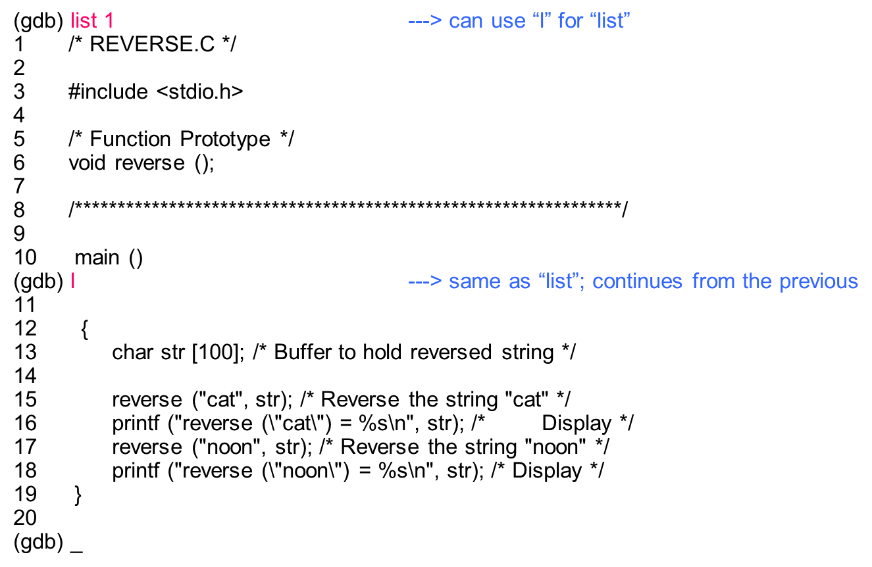
Stepping Through Code
gdb - _x0004_Example

Slide 10
Stepping Through Code
next or n
  Run program until next line, then pause. If the current line is a function, execute the entire function, then pause. Next is good for walking through your code quickly.

Slide 11
Stepping Through Code
step
  Run the next instruction, not line. If the current instructions is setting a variable, it is the same as next. If it’s a function, it will jump into the function, execute the first statement, then pause. Step is good for diving into the details of your code.

Slide 12
Stepping Through Code
finish
  Finish executing the current function, then pause (also called step out). Useful if you accidentally stepped into a function.
c[ontinue]
  continue execution (after a stop)

Slide 13
Breakpoints and Watchpoints
Breakpoints are one of the keys to debugging. They pause (break) a program when it reaches a certain location. You can examine and change variables, then resume execution. This is helpful when seeing why certain inputs fail, or testing inputs.
Useful breakpoint commands:
b[reak] [<where>] sets breakpoints. <where> can be
a number of things, including a hex
address, a function name, a line
number, or a relative line offset
[r]watch <expr> sets a watchpoint, which will break
when <expr> is written to [or read]
info break[points] prints out a listing of all breakpoints
clear [<where>] clears a breakpoint at <where>
d[elete] [<nums>] deletes breakpoints by number

Slide 14
Breakpoints and Watchpoints
break 45
break myfunction
  Set a breakpoint at line 45, or at myfunction. The program will pause when it reaches the breakpoint.

Slide 15
Breakpoints and Watchpoints
watch x == 3
  Set a watchpoint, which pauses the program when a condition changes (when x == 3 changes). Watchpoints are great for certain inputs (myPtr != NULL) without having to break on every function call.

Slide 16
Breakpoints and Watchpoints
continue or c
  Resume execution after being paused by a breakpoint/watchpoint. The program will continue until it hits the next breakpoint/watchpoint.

Slide 17
Breakpoints and Watchpoints
delete N
  Delete breakpoint N (breakpoints are numbered when created).

Slide 18
Setting Variables and Calling Functions
Viewing and changing variables at run-time is a huge part of debugging. Try giving functions invalid inputs or running other test cases to find the root of problems. Typically, you will view/set variables when the program is paused.
  print
  set
  call
  display
  undisplay

Slide 19
Setting Variables and Calling Functions
print x
  Print current value of variable x. Being able to use the original variable names is why the (-g) flag is needed; programs compiled regularly have this information removed.

Slide 20
Setting Variables and Calling Functions
set x = 3
set x = y
  Set x to a set value (3) or to another variable (y)

Slide 21
Setting Variables and Calling Functions
call myfunction()
call myotherfunction(x)
call strlen(mystring)
  Call user-defined or system functions. This is extremely useful, but beware calling buggy functions.

Slide 22
Setting Variables and Calling Functions
display x
undisplay x
  Constantly display value of variable x, which is shown after every step or pause. Useful if you are constantly checking for a certain value. Use undisplay to remove the constant display.

Slide 23
Backtrace and Changing Frames
The stack is a list of the current function calls – it shows you where you are in the program. A frame stores the details of a single function call, such as the arguments.
bt
  Backtrace, aka print the current function stack to show where you are in the current program. If main calls function a(), which calls b(), which calls c(), the backtrace is
  c <= current location b a main
  b
  a
  main
up
down
  Move to the next frame up or down in the function stack. If you are in c, you can move to b or a to examine local variables.
return
  Return from current function.

Slide 24
Crashes and Core Dumps
A “core dump” is a snapshot of memory at the instant the program crashed, typically saved in a file called “core”. GDB can read the core dump and give you the line number of the crash, the arguments that were passed, and more. This is very helpful, but remember to compile with (-g) or the core dump will be difficult to debug.
gdb myprogram core
  Debug myprogram with “core” as the core dump file.
bt
  Print the backtrace (function stack) at the point of the crash. Examine variables using the techniques above.

Slide 25
Example of a Program Crashes and Core Dumps
(gdb) run
Starting program: /home/cec/s/a/agg1/.www-docs/tutorial/main
Creating Node, 1 are in existence right now
Creating Node, 2 are in existence right now
Creating Node, 3 are in existence right now
Creating Node, 4 are in existence right now
Now removing elements:
Creating Node, 5 are in existence right now
Destroying Node, 4 are in existence right now
4
3
2
1
Program received signal SIGSEGV, Segmentation fault.
Node<int>::next (this=0x0) at main.cc:28
28 Node<T>* next () const { return next_; }
(gdb)

Slide 26
Inspecting crashes
(gdb) backtrace
#0 Node<int>::next (this=0x0) at main.cc:28
#1 0x2a16c in LinkedList<int>::remove (this=0x40160,
item_to_remove=@0xffbef014) at main.cc:77
#2 0x1ad10 in main (argc=1, argv=0xffbef0a4) at main.cc:111
(gdb)

Slide 27
Integration with Emacs
The Emacs text editor integrates well with GDB. Debugging directly inside the editor is great because you can see an entire screen of code at a time. Use M-x gdb to start a new window with GDB

Slide 28
Tips
watchpoints might be better than breakpoints. Rather than breaking on every loop and checking a variable, set a watchpoint for when the variable gets to the value you need (i == 25, ptr != null, etc.).
cout works well for tracing, but not efficient
Code speaks, so here it is. Use #define LOG_LEVEL LOG_WARN to display warnings and above. Use #define LOG_LEVEL LOG_NONE to turn off debugging.

